Slide 1
Test Automation
Getting started with testing
Using PyHamcrest matchers
Mocking
Annex
Additional testing techniques

Slide 2
Section 1: Getting Started with Testing
Setting the scene
Python test frameworks
Example class-under-test
How to write a test
Example test
Running tests
Arrange / Act / Assert
Testing for exceptions
Setup and teardown code

Slide 3
Setting the Scene
Unit testing verifies the behaviour of code artifacts in isolation
In Python, a "unit" is usually a function
You typically write several unit tests per function
To exercise all the possible paths through the function
The FIRST principles of unit testing:
Fast
Isolated / independent
Repeatable
Self-validating
Timely

Slide 4
Python Test Frameworks
There are several test frameworks for Python, including:
PyTest - simple and fast, most widely used (function-based)
Unittest (aka PyUnit) - part of standard library (OO-based)
TestProject - generates HTML reports, use with PyTest or Unittest
Behave - BDD test framework
Robot - primarily for Acceptance Testing
We'll use PyTest (plus a few other libraries, discussed later). Here's a full set of libraries to install for this chapter:
pip install pytest
pip install PyHamcrest
Discussed in section 2 in this chapter
pip install pytest-mock
Discussed in section 3 in this chapter

Slide 5
Example Class-Under-Test
In the next few slides, we'll see how to test this simple class:
class BankAccount:
def __init__(self, name):
self.name = name
self.balance = 0
def deposit(self, amount):
self.balance += amount
def withdraw(self, amount):
if amount > self.balance:
raise Exception("Insufficient funds")
self.balance -= amount
def __str__(self):
return f"{self.name}, {self.balance}"
bankAccount.py

Slide 6
How to Write a Test
To write tests in PyTest:
Define Python files named test_xxx.py or xxx_test.py
Define each test as a separate function
The function name must be test_yyy()
Each test function should focus on a particular scenario, and should have a meaningful name
E.g., test_Function_Scenario
E.g., test_Function_StateUnderTest_ExpectedBehaviour

Slide 7
Example Test
When writing your tests, go for the low-hanging fruit first
Test the simplest functions and scenarios first
Then test the more complex functions and scenarios later
Here's a simple first test
assert is a standard Python keyword
If the assert test returns false, it throws an AssertionError
This causes your test function to terminate immediately
from bankAccount import BankAccount
def test_accountCreated_zeroBalanceInitially():
acc = BankAccount("David")
assert acc.balance == 0
test_BankAccount1.py

Slide 8
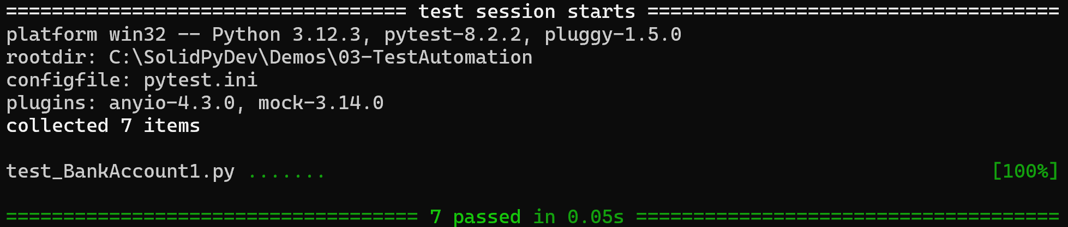
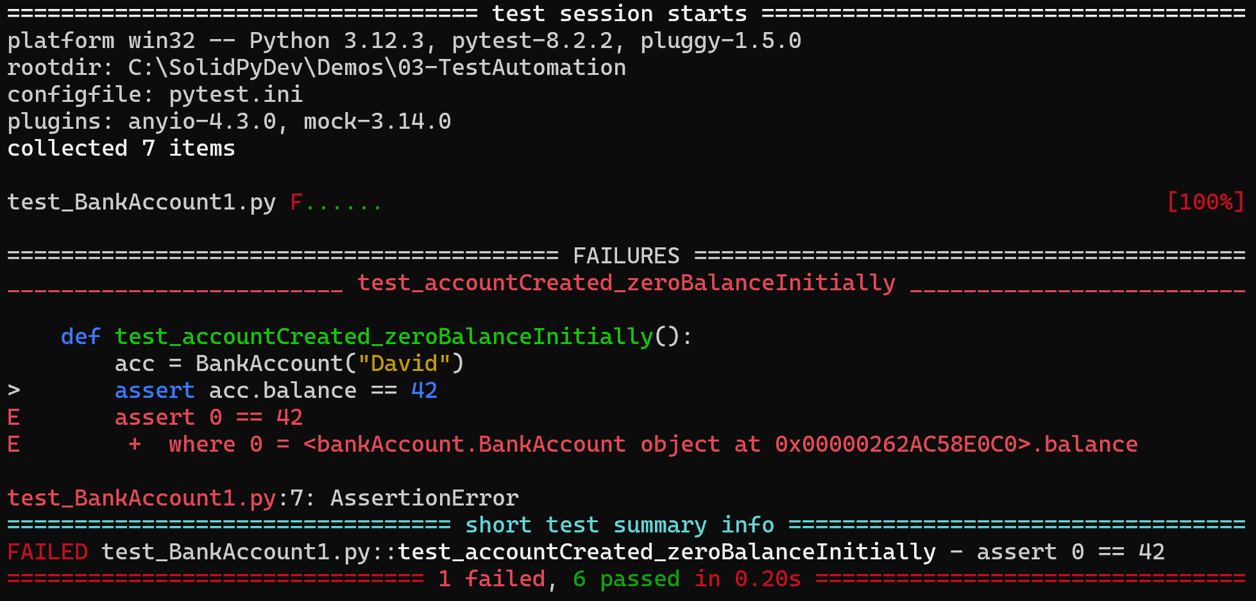
Running Tests
To run tests in PyTest, run the following command:
py.test
If all tests pass
If any test fails

Slide 9
Arrange / Act / Assert
It's common for a test function to have 3 parts
Arrange
Act
Assert
Example
def test_singleDeposit_correctBalance():
acc = BankAccount("David")
acc.deposit(100)
assert acc.balance == 100
test_BankAccount1.py

Slide 10
Testing for Exceptions (1 of 2)
When you write industrial-strength code, sometimes you actually want the code to throw an exception
The code should be robust enough to detect error situations
You can write a test to verify the code raises an error
import pytest
…
def test_withdrawalsExceedLimit_exceptionOccursV1():
# Arrange.
acc = BankAccount("David")
# Act.
acc.deposit(600)
# Verify expected exception occurs.
with pytest.raises(Exception):
acc.withdraw(601)
test_BankAccount1.py

Slide 11
Testing for Exceptions (2 of 2)
If you want to examine the exception that was thrown:
import pytest
…
def test_withdrawalsExceedLimit_exceptionOccursV2():
# Arrange.
acc = BankAccount("David")
# Act.
acc.deposit(600)
# Verify expected exception occurs.
with pytest.raises(Exception) as excinfo:
acc.withdraw(601)
# Assert the exception type and error message are correct.
assert excinfo.typename == "Exception"
assert excinfo.value.args[0] == "Insufficient funds"
test_BankAccount1.py

Slide 12
Setup and Teardown Code
You can define a fixture function to do common code before and after each test
import pytest
…
acc = None
@pytest.fixture(autouse=True)
def run_around_tests():
# Code that will run before each test.
print("Do something before a test")
global acc
acc = BankAccount("David")
# A test function will be run at this point.
yield
# Code that will run after each test.
print("Do something after a test")
To see the console output for a test, use the -s option
test_BankAccount2.py

Slide 13
Section 2: Using PyHamcrest Matchers
A reminder about simple assertions
Introducing PyHamcrest
Getting started with PyHamcrest
Example class-under-test
Example test
Defining a custom PyHamcrest matcher
Using a custom PyHamcrest matcher

Slide 14
A Reminder About Simple Assertions
As we've seen, Python has a simple assert keyword
assert a == b
What if you want to write some specific tests, such as:
Does a collection contain a value?
Does a variable point to a particular type of subclass?
Does an integer lie in a certain range?
Does a float equal a value, to a specified accuracy?

Slide 15
Introducing PyHamcrest
The PyHamcrest library provides a higher-level vocabulary for writing your tests, with matcher functions such as:
equal_to, close_to, not
greater_than, greater_than_or_equal_to
less_than, less_than_or_equal_to
starts_with, ends_with, contains_string, is_empty
all_of, any_of
contains_string, contains_exactly, contains_in_any_order
has_item, has_items
has_entry, has_entries, has_key, has_keys, has_value, has_values
instance_of
… etc.

Slide 16
Getting Started with PyHamcrest
Install PyHamcrest as follows:
You can then use PyHamcrest as follows in your tests:
pip install PyHamcrest
from hamcrest import *
…
assert_that(… … …)

Slide 17
Example Class-Under-Test
To illustrate PyHamcrest, we'll test the following class:
class Product:
def __init__(self, description, price, *ratings):
self.description = description
self.price = price
self.ratings = list(ratings)
def taxPayable(self):
return self.price * 0.20
def __str__(self):
return f"{self.description}, £{self.price}, {self.ratings}"
product.py

Slide 18
Example Test
Here's how we can use PyHamcrest to test the class:
from hamcrest import *
import pytest
from Product import Product
product = None
@pytest.fixture(autouse=True)
def run_around_tests():
global product
product = Product("TV", 1500, 5, 4, 3, 5, 4, 3)
yield
def test_product_taxPayable_correct():
assert_that(product.taxPayable(), close_to(300, 0.1))
def test_product_ratings_containsRating():
assert_that(product.ratings, has_item(3))
def test_product_ratings_doesntContainAbsentRating():
assert_that(product.ratings, not(has_item(2)))
test_Product1.py

Slide 19
Defining a Custom PyHamcrest Matcher
The PyHamcrest matcher model is extensible
You can define your own custom matcher classes
from hamcrest.core.base_matcher import BaseMatcher
class PriceMatcher(BaseMatcher):
def __init__(self, maxInclusive):
self.maxInclusive = maxInclusive
def _matches(self, price):
return 0 < price <= self.maxInclusive
def describe_to(self, description):
description.append_text("0..." + str(self.maxInclusive))
def valid_price():
return PriceMatcher(2500)
priceMatcher.py

Slide 20
Using a Custom PyHamcrest Matcher
Here's how to use a custom PyHamcrest matcher
Exactly the same as for the standard PyHamcrest matchers ☺
from hamcrest import *
from priceMatcher import valid_price
from product import Product
def test_product_validPrice_priceAccepted():
product1 = Product("TV", 1500)
assert_that(product1.price, valid_price())
def test_product_negativePrice_priceRejected():
product2 = Product("TV", -1)
assert_that(product2.price, is_not(valid_price()))
def test_product_tooExpensivePrice_priceRejected():
product3 = Product("TV", 2501)
assert_that(product3.price, is_not(valid_price()))
test_Product2.py

Slide 21
Section 3: Mocking
Overview of mocking
Mocking in Python
Mocking values
Mocking functions
Mocking methods

Slide 22
Overview of Mocking
Real-world systems involve lots of interacting code
Unit testing focuses on the behaviour of an isolated unit
We can use mocks to blank off other code
Mocking
Use a mocking framework to create a mock value/function/object
In tests, use the mock value/function/object rather than a real one

Slide 23
Mocking in Python
The PyUnit module has standard support for mocking
Via the unittest.mock module
PyTest-mock is a thin wrapper over unittest.mock
Provides a mocker fixture
You can use mocker to patch values/functions/classes
To install PyTest-mock:
Let's see how to use PyTest-mock
See the mockdemo package folder
pip install pytest-mock

Slide 24
Mocking Values (1 of 2)
Consider this value defined somewhere in our app:
We use the value in our code-under-test:
BASE_URL = "https://example.com/api/products"
myDependencies.py
mockdemo/myDependencies.py
from mockdemo.myDependencies import BASE_URL
def build_url(**kwargs):
url = BASE_URL
if len(kwargs) != 0:
url += "?"
for k, v in kwargs.items():
url += f"{k}={v}&"
url = url.rstrip('&')
return url
myCode.py
mockdemo/myCode.py

Slide 25
Mocking Values (2 of 2)
We can mock the value in our test as follows:
Receive a mocker fixture object (from PyTest-mock)
Use the mocker object to define a mock value for BASE_URL
import mockdemo.myCode as myCode
def test_build_url(mocker):
mocker.patch.object(myCode, 'BASE_URL', 'http://localhost/products')
actual = myCode.build_url(minPrice=100, maxPrice=500, order='desc')
expected = 'http://localhost/products?minPrice=100&maxPrice=500&order=desc'
assert expected == actual
mockdemo/test.py

Slide 26
Mocking Functions (1 of 2)
Consider this (slow) function somewhere in our app:
We call the function in our code-under-test:
def calculate_meaning_of_life():
time.sleep(60)
return 42
mockdemo/myDependencies.py
from mockdemo.myDependencies import calculate_meaning_of_life
def get_meaning_of_life():
result = calculate_meaning_of_life()
return 'The meaning of life is ' + str(result)
mockdemo/myCode.py

Slide 27
Mocking Functions (2 of 2)
We can mock the function in our test as follows:
Receive a mocker fixture object (from PyTest-mock)
Use the mocker object to mock the return value for the function
import mockdemo.myCode as myCode
def test_get_meaning_of_life(mocker):
mocker.patch(
'mockdemo.myCode.calculate_meaning_of_life',
return_value='wibble'
)
actual = myCode.get_meaning_of_life()
expected = 'The meaning of life is wibble'
assert expected == actual
test.py
mockdemo/test.py

Slide 28
Mocking Methods (1 of 2)
Consider this class (with slow methods) somewhere in our app:
We call some of these methods in our code-under-test:
class DataLoader:
def __init__(self):
self.delay = 60
def load_product(self):
time.sleep(self.delay)
return 'Bugatti Divo'
def load_great_football_team(self):
time.sleep(self.delay)
return 'Swansea City'
myDependencies.py
mockdemo/myDependencies.py
from mockdemo.myDependencies import DataLoader
def get_product():
dataLoader = DataLoader()
result = dataLoader.load_product()
return 'Product is ' + str(result)
mockdemo/myCode.py

Slide 29
Mocking Methods (2 of 2)
We can mock methods in our test as follows:
Receive a mocker fixture object (from PyTest-mock)
Use the mocker object to mock methods as needed
import mockdemo.myCode as myCode
def test_get_product(mocker):
mocker.patch(
'mockdemo.myCode.DataLoader.load_product',
lambda self: 'wibble'
)
actual = myCode.get_product()
expected = 'Product is wibble'
assert expected == actual
mockdemo/test.py

Slide 30
Summary
Getting started with testing
Using PyHamcrest matchers
Mocking

Slide 31
Annex: Additional Testing Techniques
Parameterized tests
Running tests selectively
Grouping tests into sets
Test Driven Development (TDD)
Refactoring

Slide 32
Parameterized Tests (1 of 2)
When you start writing tests, you might notice some of the tests are quite similar and repetitive
E.g., imagine a function that returns the grade for an exam
How would you test it always returns the correct grade?
def get_grade(mark):
if mark >= 75:
return "A*"
elif mark >= 70:
return "A"
elif mark >= 60:
return "B"
elif mark >= 50:
return "C"
elif mark >= 40:
return "D"
elif mark >= 30:
return "E"
else:
return "U"
util.py

Slide 33
Parameterized Tests (2 of 2)
You can write a parameterized test as follows:
import pytest
from util import get_grade
@pytest.mark.parametrize("mark, grade", [
(99, "A*"),
(70, "A"),
(69, "B"),
(60, "B"),
(59, "C"),
(50, "C"),
(49, "D"),
(40, "D"),
(39, "E"),
(30, "E"),
(29, "U")
])
def test_marks_and_grades(mark, grade):
assert grade == get_grade(mark)
test_util.py

Slide 34
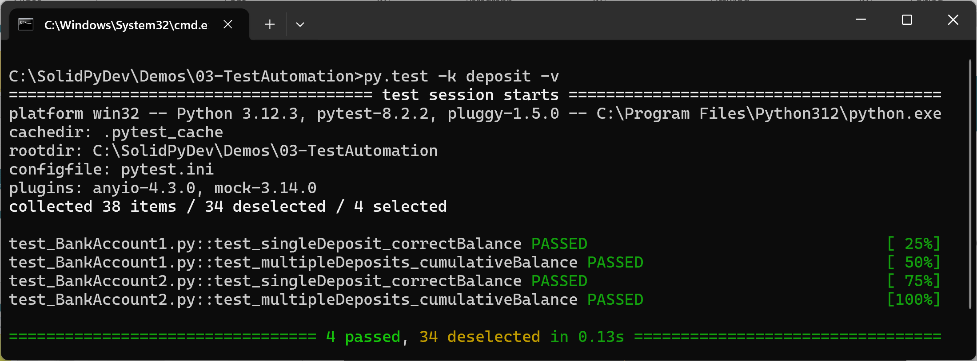
Running Tests Selectively
py.test lets you specify which test functions to run…
E.g., run all test functions that have 'deposit' in their name
The -k option specifies the key (function name fragment)
The -v option displays verbose test results
py.test -k deposit -v

Slide 35
Grouping Tests into Sets (1 of 3)
You can group tests into sets
You can then run all the tests in a particular set
The first step is to specify your custom sets
Define a file named pytest.ini as follows:
[pytest]
markers =
numtest: mark a test as a numeric test
strtest: mark a test as a string test
pytest.ini

Slide 36
Grouping Tests into Sets (2 of 3)
You can then mark a test function so it belongs to a set(s)
Decorate the test function with @pytest.mark.aSetName
import pytest
@pytest.mark.numtest
def test_add_numbers():
assert 3 + 4 == 7
@pytest.mark.numtest
def test_multiply_numbers():
assert 3 * 4 == 12
@pytest.mark.strtest
def test_concatenate_strings():
assert "hello " + "world" == "hello world"
@pytest.mark.strtest
def test_uppercase_strings():
assert "hello world".upper() == "HELLO WORLD"
test_setsDemo.py

Slide 37
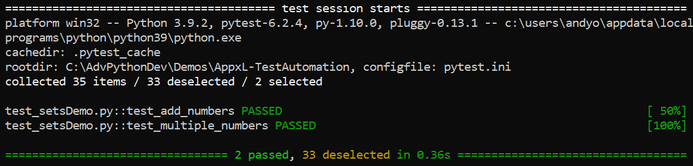
Grouping Tests into Sets (3 of 3)
To run all the tests in a particular set:
Use the -m option
Specifies which marked tests to run (i.e., the name of the set)
py.test -m numtest -v

Slide 38
Test Driven Development (TDD)
TDD is a simple concept
You write the tests first, before your write the code
The tests are for functionality you're about to implement
In TDD, you perform the following tasks repeatedly:
Write a test
Run the test - it must fail!
Write the minimum amount of code, to make the test pass
Refactor your code
Benefits of TDD
Helps you focus on functionality rather than implementation
Ensures every line of code is tested

Slide 39
Refactoring
Refactoring is an often-overlooked aspect of TDD
After each iteration through the test-code-pass cycle, you should refactor your code
That is, step back and see if you can/should reorganize your code to eliminate duplication, restructure inheritance, etc.
Typical refactoring activities:
Rename a variable / function / class / module / package
Extract duplicate code into a common function
Extract common class functionality into a superclass
Introduce another level of inheritance

